Slide 1

TITLE :
FUEL FRAUD PATTERN DETECTION ENGINE
Student Name: A- DEERAJ
Student Id: 2520030113
Cluster: 1
Section: 1
Under The Guidance
Of
Supervisor Name: Dr.Ramakanth
Assistant Professor
Department of CSE
(DEEMED TO BE UNIVERSITY)

Slide 2
KLH
OUTLINE
1. Abstract
2. Existing System
3. Proposed System
4. System Architecture
5. Project Modules
6. Objectives
7. Co's Attainments - FWD (CO1...CO5)
8. Co's Attainments - DSA (CO1...CO5)
9. Screen Shots for FWD & DSA
10. Conclusion
11. Geo-Tagged Photos
📋

Slide 3
ABSTRACT
FFPE (Fuel Fraud Pattern Engine) is a fleet monitoring system designed to detect fuel theft in campus transport buses. The system continuously monitors three fuel parameters — tank fuel level, ECU (Engine Control Unit) fuel consumption, and expected fuel value — and compares them in real time.
When the fuel mismatch exceeds a threshold of 5 liters, the system automatically detects fraud. The live dashboard (HTML/CSS/JavaScript) fetches data from a Python Flask backend every 3 seconds and updates the status visually. Upon fraud detection, an instant Telegram bot alert is sent to the transport manager, containing the Bus ID, fuel loss amount, GPS link, and timestamp. A Java implementation of the core fraud detection algorithm is also included to demonstrate the DSA logic.

Slide 4
EXISTING SYSTEM
(FUEL FRAUD PATTERN ENGINE)
In the existing fleet management approach, fuel monitoring is largely manual. Transport supervisors physically check fuel gauges and compare odometer readings with fuel refill logs at the end of each route. There is no automated mechanism to cross-verify tank sensor readings with ECU data in real time.
Fraudulent activities such as fuel siphoning often go undetected for long periods, leading to significant financial losses. Alerts, if any, are communicated manually through phone calls or messages, causing delays in response. The lack of a structured, real-time monitoring system makes it difficult to identify patterns of repeated fraud or pinpoint specific buses or routes where theft is occurring.

Slide 5
KLH
PROPOSED SYSTEM
The proposed FFPE system introduces an automated, real-time fuel fraud detection solution for campus bus fleets. Fuel sensor data (tank level and ECU consumption) is fed into a Python Flask backend which compares values against an expected fuel level. If the mismatch exceeds 5 liters, the system flags the event as fraud.
The live web dashboard (HTML/CSS/JS) auto-refreshes every 3 seconds to display current fuel readings and detection status. On fraud detection, a Telegram bot instantly dispatches an alert message to the transport manager with Bus ID, fuel loss, GPS tracking link, and timestamp. Additionally, the core fraud detection logic is implemented in Java to demonstrate the DSA algorithm. Future improvements include direct IoT sensor integration, route-based fuel profiling, and data analytics for fleet-wide insights.

Slide 6
KLH
SYSTEM ARCHITECTURE
1. Sensor / Input Layer
Tank Fuel Sensor, ECU Fuel Data, Bus Route & GPS Link
2. Backend / Processing Layer (Flask)
API Key Auth → Compare Tank vs ECU vs Expected → Detect Fraud
3. Alert / Output Layer (Telegram)
Send Fraud Alert: Bus ID, Fuel Loss, GPS, Timestamp
4. Frontend Layer (Dashboard)
Live HTML Dashboard — Auto-refresh every 3 sec via /latest API

Slide 7
KLH
PROJECT MODULES
The FFPE system is divided into the following modules:
1. Live Dashboard Module
HTML/CSS/JS frontend that auto-refreshes every 3 seconds, displaying Tank Fuel, ECU Fuel, Expected Fuel, Bus Route, and fraud status.
2. Backend Detection Module (Flask)
Python Flask API that receives fuel data, validates API key, computes mismatch, and returns fraud or normal status.
3. Telegram Alert Module
On fraud detection, sends an instant alert to the transport manager via Telegram Bot API with Bus ID, fuel loss, GPS link, and time.
4. DSA / Java Module
Java implementation of the fraud detection algorithm using absolute difference logic to demonstrate the core DSA concept.

Slide 8
KLH
OBJECTIVES
The main objective of FFPE is to build an automated, real-time fuel fraud detection system for campus bus fleets. It aims to replace manual fuel auditing with a technology-driven solution that continuously compares tank sensor readings with ECU data and expected fuel values.
Another objective is to demonstrate the practical application of web development (FWD) and data structures & algorithms (DSA) in solving a real-world problem. The system ensures instant alerts on fraud detection via Telegram, enabling rapid response from fleet managers. Future objectives include integration with actual IoT fuel sensors, GPS vehicle tracking, and fleet-wide analytics for pattern-based fraud prevention.

Slide 9
KLH
CO'S ATTAINMENTS – FWD
CO1: Design a user interface for the Fuel Fraud Detection live dashboard using HTML and CSS.
CO2: Use HTML and CSS to create structured and visually styled web pages for the FFPDE system.
CO3: Use JavaScript to implement auto-refresh, fetch API calls, and dynamic status updates on the dashboard.
CO4: Create an interactive dashboard with live fuel monitoring, route selection, and manual analyze functionality.
CO5: Integrate the frontend with a Flask REST API backend for real-time bidirectional data communication.

Slide 10
KLH
CO'S ATTAINMENTS – DSA
CO1: Understand and implement the absolute difference algorithm for fuel mismatch calculation in Java.
CO2: Apply conditional logic to classify fuel states as FRAUD DETECTED or NORMAL based on threshold comparison.
CO3: Demonstrate the use of floating-point arithmetic (Math.abs) and control flow in solving a real-world detection problem.
CO4: Design a step-by-step algorithm for fraud detection, tested with real sensor value scenarios.
CO5: Implement and run the Java fraud detection program with sample data to validate the algorithm output.

Slide 11
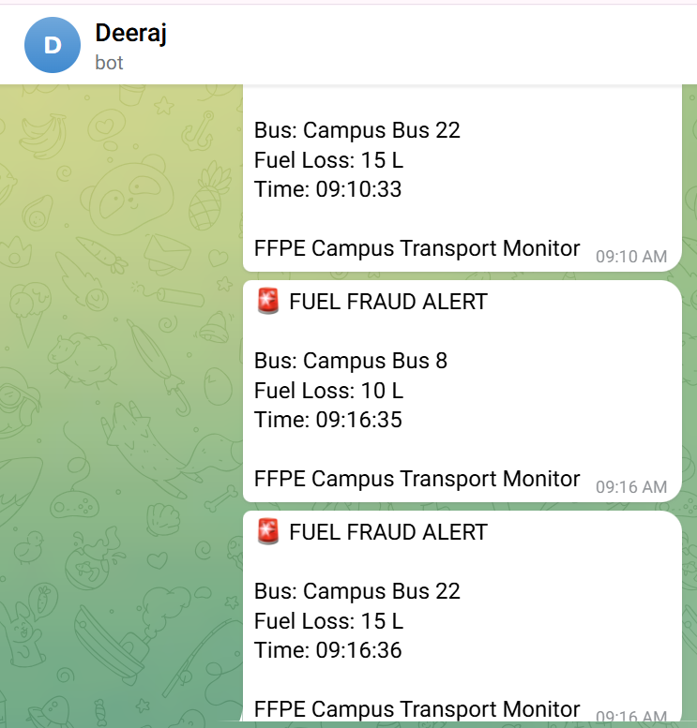
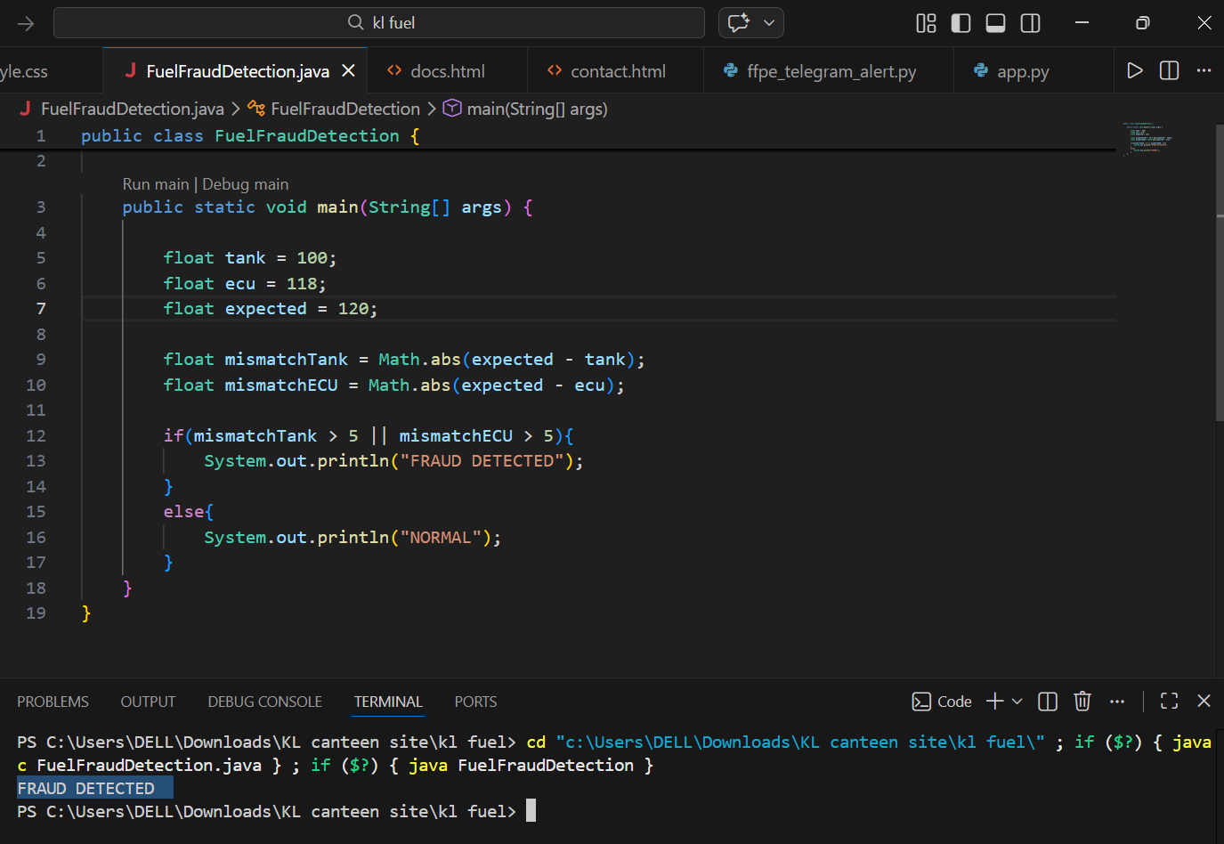
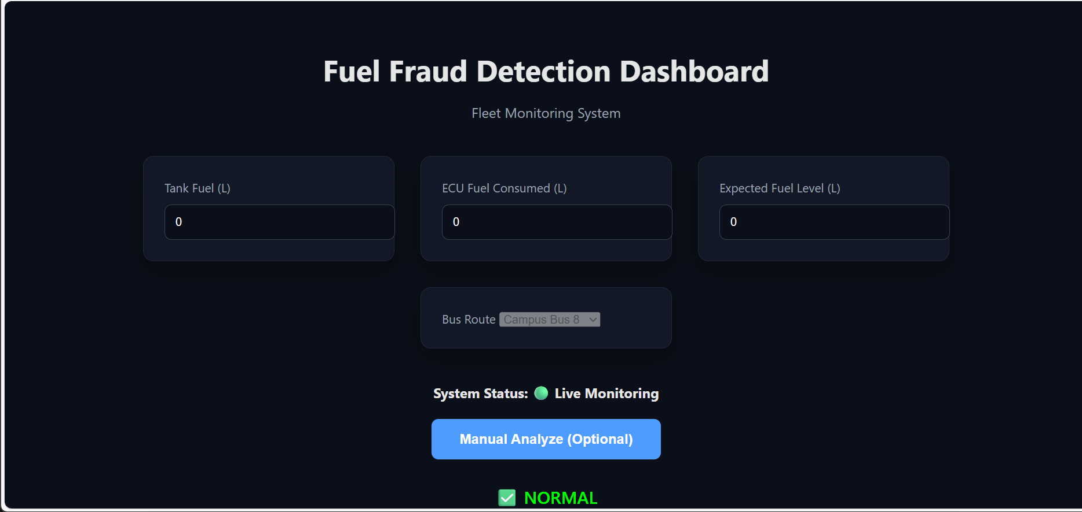
KLH
SCREEN-SHOTS OF FWD & DSA
[Add Screenshot Here]
[Add Screenshot Here]
[Add Screenshot Here]
Dashboard – Normal State
Dashboard – Fraud Detected
Java DSA Output

Slide 12
KLH
CONCLUSION
The FFPE (Fuel Fraud Pattern Engine) project successfully demonstrates how a real-time web-based system can be built to detect fuel fraud in campus bus fleets. By comparing tank sensor readings, ECU consumption, and expected fuel values, the system achieves accurate fraud detection with a simple threshold-based algorithm.
The project integrates Frontend Web Development (HTML, CSS, JavaScript), Backend Engineering (Python Flask), Telegram Bot API for instant alerting, and a Java-based DSA implementation of the core algorithm. Together, these components form a complete, working solution that reduces manual effort, ensures real-time visibility, and enables rapid incident response. This project effectively demonstrates the use of programming concepts and structured system development to address a practical, real-world transport management problem.

Slide 13
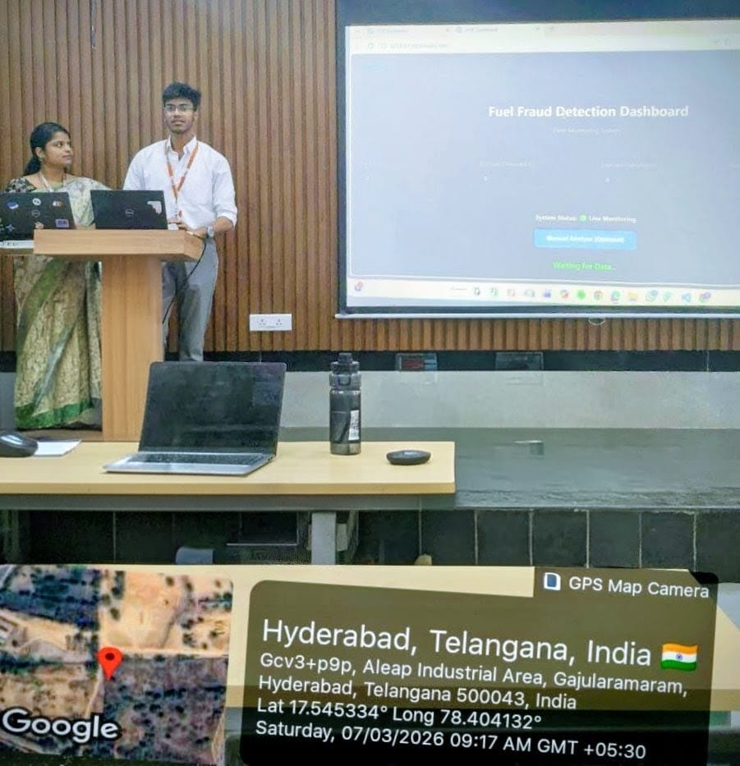
KLH
GEO-TAG
[Add Geo-Tagged Photo Here]
Hyderabad, Telangana, India
Date & GPS Coordinates

Slide 14
KLH
📋✅
THANK YOU

